Slide 1
What is A Graphic Novel?
There are many debates about the exact definition. What is USUALLY agreed on is this:
A graphic novel is a sequential, comic-style narrative in book form.
A graphic novel is a medium not a genre (a graphic memoir is a graphic novel; a graphic history is a graphic novel|)

Slide 2
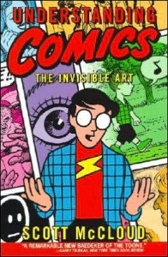

Slide 3
GRAPHIC NOVEL CONVENTIONS
PARTS OF THE PAGE
  Panels
  Frames
  Gutter
  Speech bubbles
  Captions
  Sound Effects
Transitions
Perspective
Notes:
Understanding the conventions of a graphic novel helps both the student and teacher access the text and enjoy the story. Looking for conventions helps students hone their critical thinking skills and puts them into a learning relationship with the text they are reading.

Slide 4
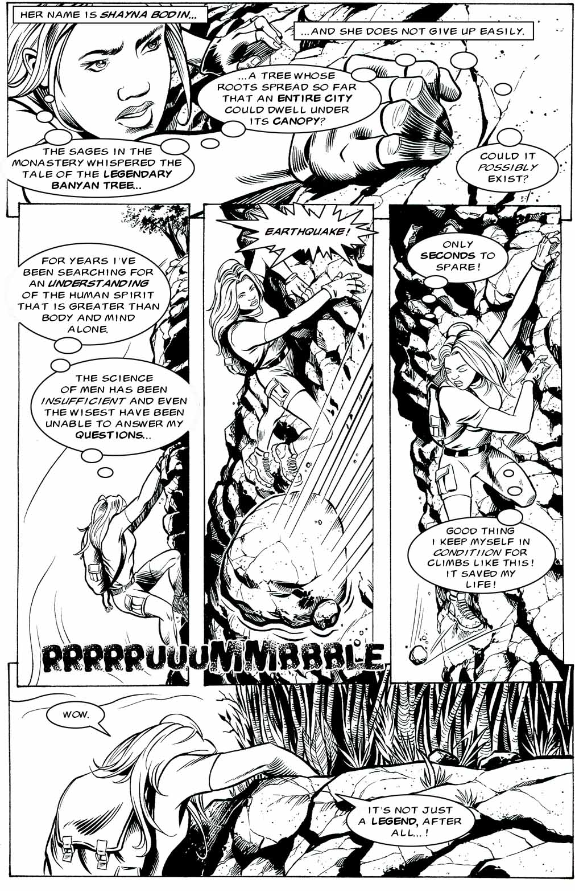
Caption
Panel
Gutter
Thought Bubble
Scream Bubble
Frame
Sound Effect
Dialogue Bubble

Slide 5
Speech and Thought Bubbles
Notes:
Different types of speech bubbles (what does each indicate?) 1. thinking 2. explosive idea/anger 3. whispering

Slide 6
GRAPHIC NOVEL
CONVENTIONS
TRANSITIONS
    Slow down an emotional moment
    Show an action sequence
    Use juxtaposition to create meaning
PERSPECTIVE
    Same vocabulary as film and photography
      Close-up, medium-shot, long-shot
      Tilt-up, tilt-down
      Panning and tracking

Slide 7
Transitions
Panel to panel transitions are relationships described in
Scott McCloud's Understanding Comics:
He defines six transitions from one panel to the next:
Moment-to-moment
2. Action-to-action
3. Subject-to-subject
4. Scene-to-scene
5. Aspect-to-aspect
6. Non-sequitur
(http://www.comixpedia.org/index.php?title=Panel-to-panel_transitions)

Slide 8
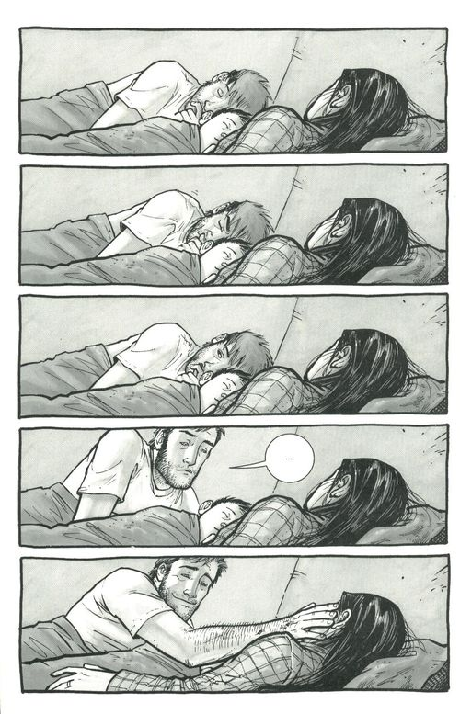
The Walking Dead
Moment-to-moment:
Relatively little change takes place between the two panels.
In writing, this is when an important moment is “slowed down”.

Slide 9
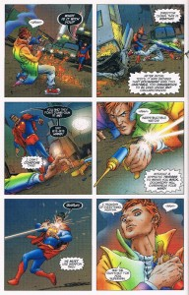
Star Superman
Action-to-action:
The actions of a single subject are shown.
In writing, this is when shorter paragraphs of descriptive action and dialogue is used.

Slide 10
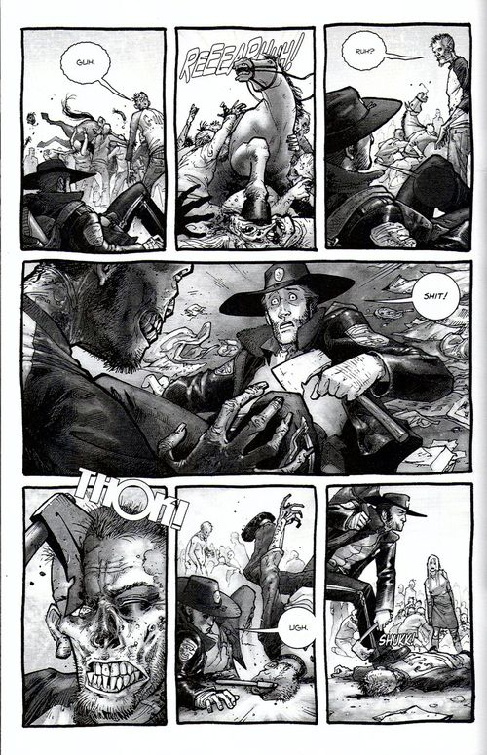
The Walking Dead
Subject-to-subject:
Transitions between different subjects in the same scene.
This is common, especially in conversations.

Slide 11
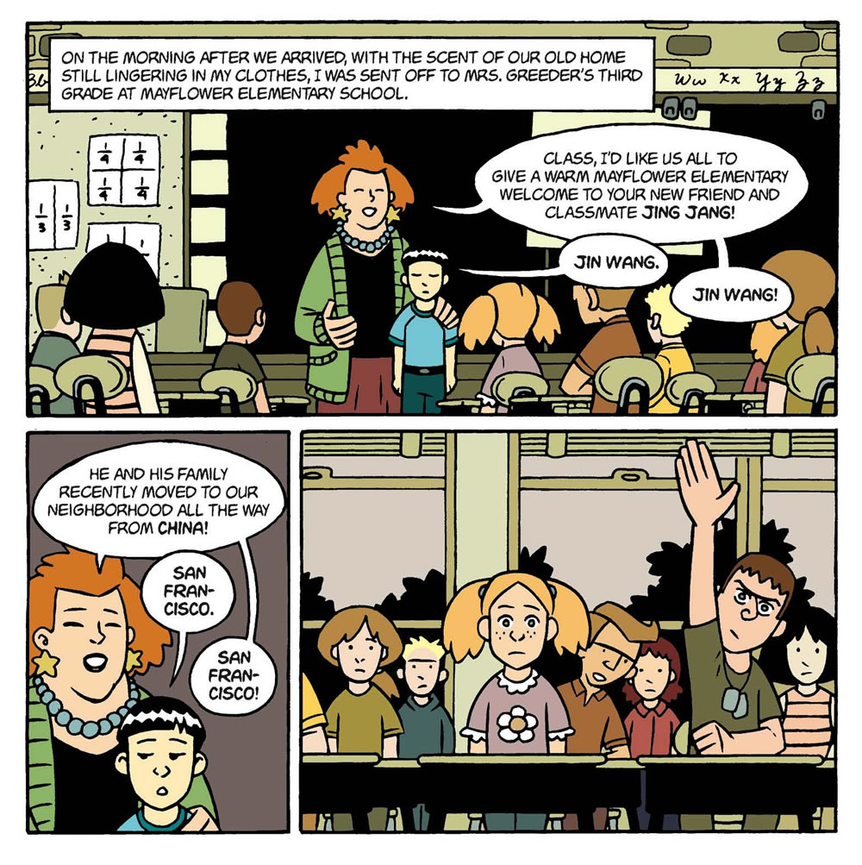
American Born Chinese

Slide 12
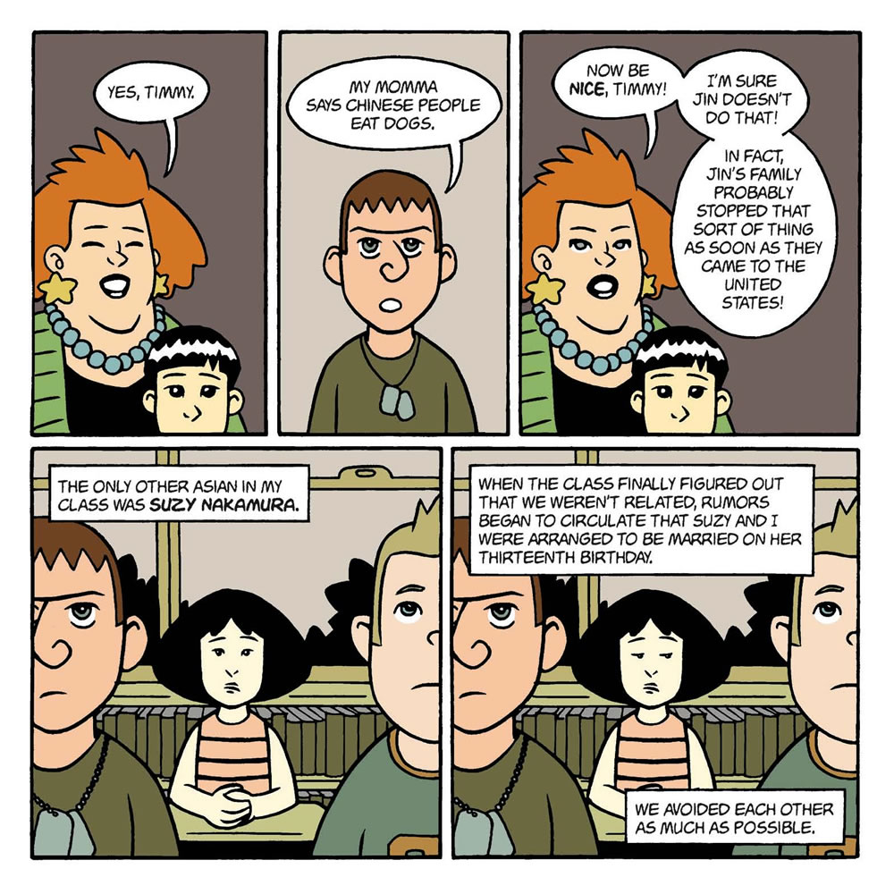
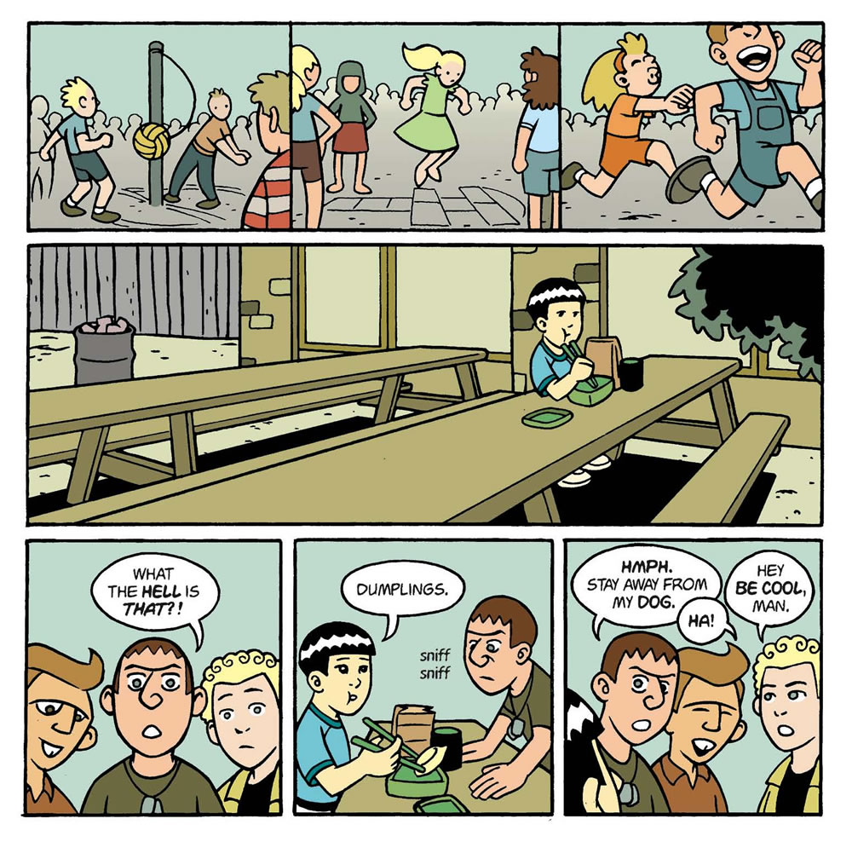

Slide 13
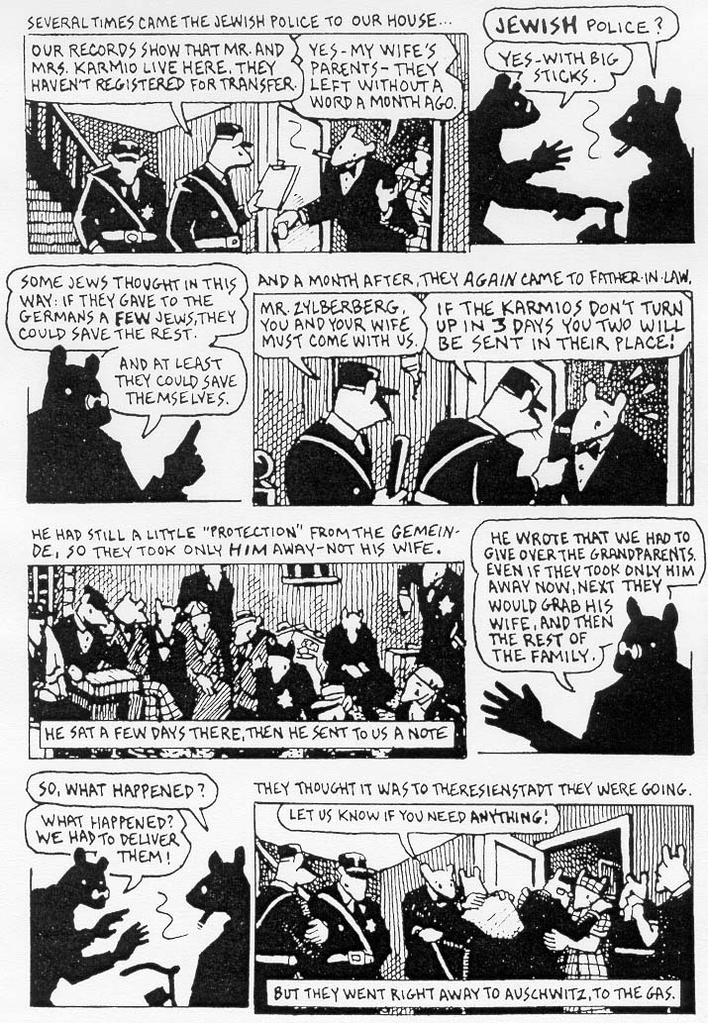
MAUS
Scene-to-scene:
“Transports us across significant distances of time and space.“
In writing, this can be a flashback or a switch of perspective, or a new paragraph or chapter.

Slide 14
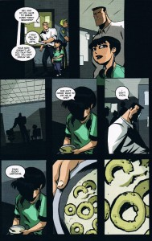
Who Killed Retro Girl?
Aspect-to Aspect:
“Bypasses time for the most part and sets a wandering eye on different aspects of a place, idea, or mood.“
In writing, this is a creative way to describe one scene in multiple ways.

Slide 15
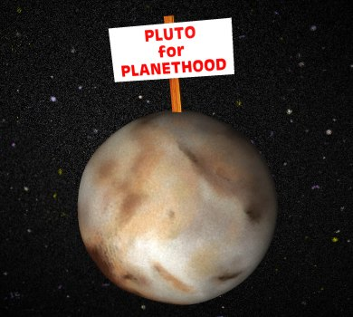

ORIGINAL
NON-SEQUITUR
Here, there is seems to be no logical connection between panels. Of course, because they are juxtaposed with one another, reader try to create meaning.
In writing, this is experimental or abstract. Often its intent is to make the reader work to make connections.

Slide 16
WHY IS READING GRAPHIC NOVELS
IMPORTANT?
Engaging
Superb texts
Can be read more quickly and re-read for deeper analysis
Visual way for students to learn literary ideas (juxtaposition, metaphor, simile, intertextuality, metafiction, “showing vs. telling”, dialogue, themes, style, etc.)
Visual way to practice reading strategies

Slide 17
WHY IS CREATING GRAPHIC PANELS
OR SHORT PANEL SEQUENCES
A GOOD IDEA?
Engaging
Students, over time, create strong texts
Can be read more quickly and re-read for deeper analysis
Visual way for students to demonstrate level of understanding of literary ideas (juxtaposition, metaphor, simile, intertextuality, metafiction, “showing vs. telling”)
Less stigma for experimenting and sharing

Slide 18
ACTIVITIES
HOW ARE YOU FEELING TODAY?
Student Instructions:
Look at the feeling panel and choose the feeling that best represents your mood.
In the panel provided, draw a picture of yourself (Close-up? Far-shot? Mid-shot?)
Remember, our expressions often masks our feelings
Include thought bubble, speech bubble and caption.
If it isn’t clear on the panel, writing the feeling word on the back of the panel.

Slide 19
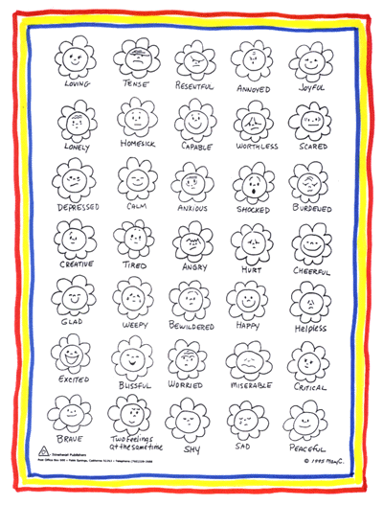
a

Slide 20
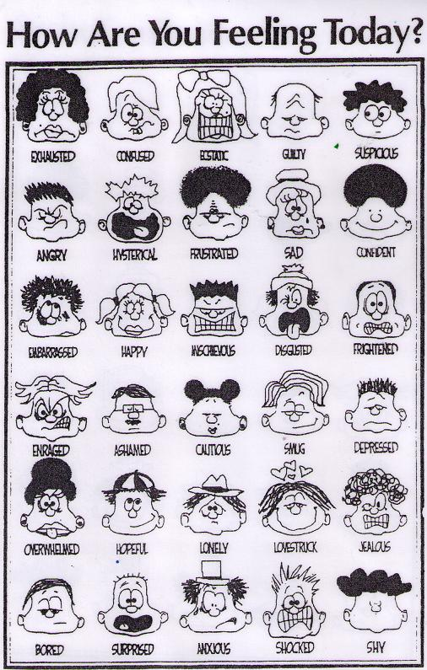

Slide 21
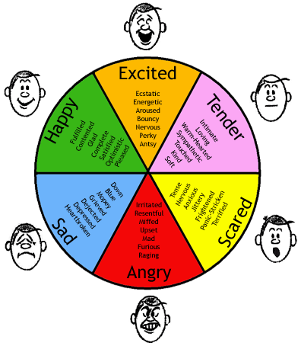

Slide 22
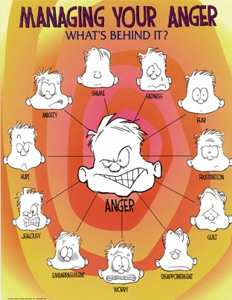

Slide 23
HOMEWORK CHECKS
Student Instructions:
Create a one page comic with 5 – 9 panels that explains how you completed your homework, what you learned and questions and obstacles you faced. Include as much content from the reading as possible.
On the reverse, scale (rate) your satisfaction with your knowledge. Write down one strategy to improve your number by one or two points.

Slide 24
SHOWING VS. TELLING
Student Instructions:
Divide your page into six panels. In the first three panels, show person A’s sadness. In the last three panels, show person B’s sadness. Use captions, dialogue and thought bubbles.
Divide your page into six panels. Create a sequence that shows a person feeling ambivalent about a situation.

Slide 25
SLOW IT DOWN
Student Instructions:
Create a moment-to-moment six panel sequence that shows you waking up for school, getting frustrated in class, hugging someone, avoiding eye-contact, hiding your cell-phone, etc.
Create an aspect-to-aspect panel sequence of the same event.

Slide 26
ASSESSMENT OF LEARNING
Use previously created panels in final reflective piece: add beginning, middle and end panels to create a reflective story
Creating graphic memoirs (see assignment sheet)
Create a graphic reflection (se assignment sheet)

Slide 27


Slide 28
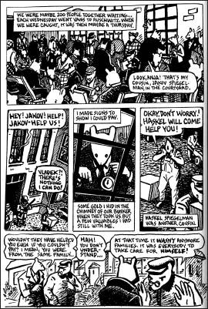

Slide 29
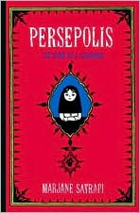

Slide 30
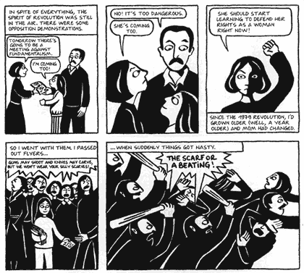

Slide 31
CAUTION:
Too many of these activities (like too much of anything!) can be annoying for students. Use them 3 – 5 times throughout the year and be clear about your objectives and why you are using this strategy. In addition to reflection, use them as building blocks to ensure learning of graphic elements in preparation for a final assignment.

Slide 32
GRAPHIC BURSTS
Reduces stigma (it’s OK to be “bad” at drawing)
Enhances understanding of reading strategies
Retention of images is often stronger than retention of written or oral ideas
Quick to complete and quick to assess
Facilitates sharing and reflection
  Easy for students to see progression
Enhances reading, writing and media skills
Allows for bursts of success
Integrates equity: diversity of experience, recognizes and respects a variety of stories

Slide 33
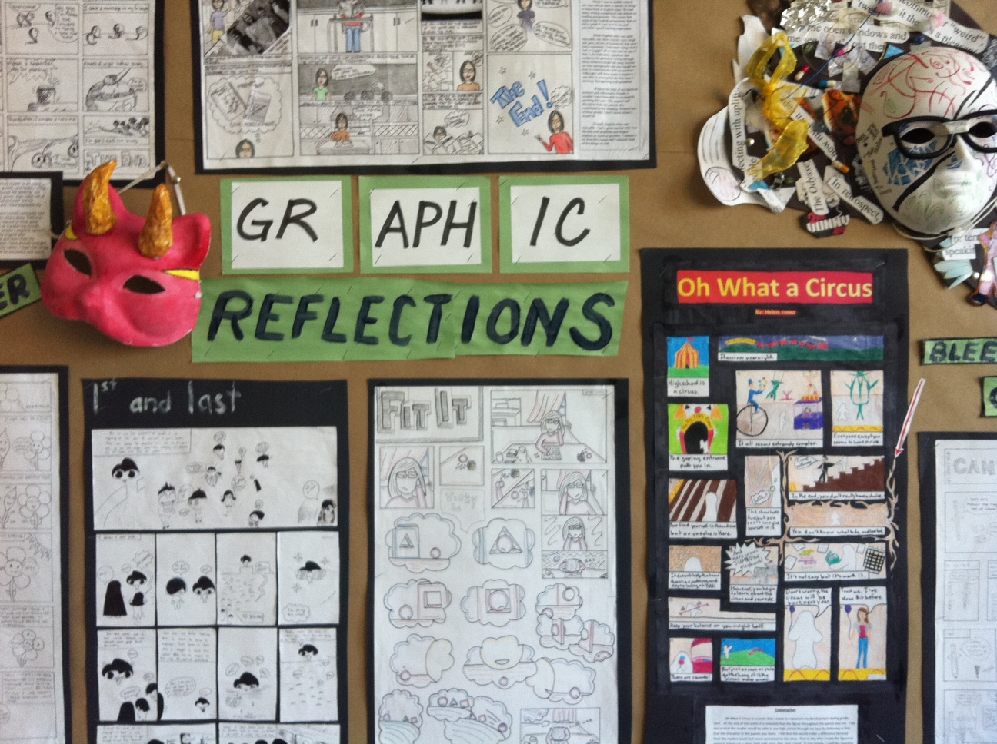

Slide 34
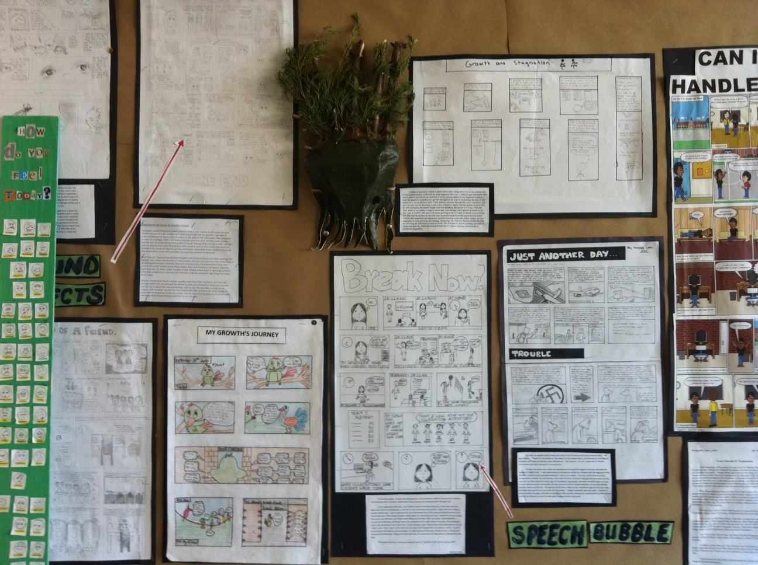

Slide 35
Graphic Novel Suggestions
Understanding Comics Scott McCloud
Making Comics Scott McCloud
Any book that shows step-by-step drawing of comics
Persepolis by Marjane Satrapi
The Complete Maus by Art Spiegielman
Stitches by David Small
Fun Home by Alison Bechdel
American Born Chinese
Essex County by Jeff Lemire
The Odyssey by Gareth Hinds
*Sita’s Ramayana by Moyna Chitrakar and Samhita Arni
*Fist Stick Knife Gun by Canada
*Shaun Tan The Arrival
*Aya by Marguerite Abouet
Art Panels, BAM! Speech Bubbles, POW!: Writing Your Own Graphic Novel by
Trisha Speed and Stephen Shaskan

Slide 36


